Slide 1
R1 arm training
Torso avoidance, grasping and lifting
120 focused lift-search episodes
No scripted teacher. No DAgger episodes.
MuJoCo simulation
October 2026
Notes:
New presentation following R1 RL Training IEEE Final.pptx. Training and evaluation performed October 18, 2026. Prepared October 21, 2026. Focused phase has 120 candidate search episodes, plus an initial baseline evaluation. See [6].

Slide 2
Training method
Existing SAC policy
Continue from the latest 1.2-million-step policy, at a contact state that it reaches naturally.
Focused policy search
CEM optimizes 18 coefficients for a smooth arm-and-hand motion, using episode rewards [3].
Physical reward
Reward unsupported lift and stable grip. Penalize drops and torso contact. Table pressing earns no lift reward.
Short training budget
120 search episodes of 8-second motion. Verify the result with a separate 5-second stationary hold.
2
Notes:
SAC is Soft Actor-Critic [1], used for the existing feedback policy. CEM is the cross-entropy method [3], an established reward-based policy-search optimizer, not a newly invented optimizer. The task-specific method combines the learned SAC contact state with CEM over 3 motion knots times 6 channels = 18 coefficients. Six active finger motors receive a common closure command. No teacher trajectory or DAgger data. HER [2] is background for earlier reaching work, not a claim that this lift phase uses HER. Implementation: /Users/cesarpascal/Documents/Training/real_r1_arm_policy/rl_grasp/focus_lift.py. Report: /Users/cesarpascal/Documents/Training/real_r1_arm_policy/rl_grasp/runs/focused_hold_lift/report.json. Independent evaluation: hold_report.json.

Slide 3
Physical grasp mechanics
Arm and hand
Five arm velocity commands position the hand. A shared closure command drives six active finger motors.
Opposing contact
The thumb and at least one other finger contact the ball. The grasp point stays within 9 cm of its center.
Stable lift
The ball rises at least 3 cm, leaves the support, and moves below 0.20 m/s for the stable-grasp criterion.
Physical simulation
The ball remains a free body under full gravity. Finger and palm contacts provide the grip.
3
Notes:
Sources: /Users/cesarpascal/Documents/Training/real_r1_arm_policy/rl_grasp/grasp_env.py, step(), contacts(), and model setup. Stable state requires opposing finger contact, distance <0.09m, lift >=0.03m, no object support contact, and object speed <0.20m/s. Ten consecutive stable control steps define the training environment success streak. Hand has six active finger motors, not six independent action dimensions. Focused hold verification: /Users/cesarpascal/Documents/Training/real_r1_arm_policy/rl_grasp/runs/focused_hold_lift/hold_report.json and support_validation.json.

Slide 4
Rewards for lifting and torso avoidance
Lift and grip
Favor greater unsupported lift while the thumb and another finger keep contact. Reward held contact each step.
Support and motion
Penalize object support contact, hand contact with the table, grasp distance, and large motor commands.
Episode score
Add 2,000 for success. Subtract 200 for torso contact and 80 for a drop during the focused rollout.
Torso-aware reaching
The preceding reach policy also learns from torso proximity and contact penalties. Slide 6 reports its audit.
4
Notes:
Focused score source: /Users/cesarpascal/Documents/Training/real_r1_arm_policy/rl_grasp/focus_lift.py, rollout(). Step value: 40*clip(lift/.05,-2,2)*(1 if held else .1)+8*held-2*support-.6*hand_table-5*min(distance/.08,4)-.02*mean(action^2). held requires thumb plus >=2 distinct finger contacts and no support. Episode score includes scaled mean/late value, +100*max(0,best_held_lift)/.05, +2000*success, -200*collision, -80*dropped. These weights describe the focused controller, distinct from the grasp SAC and reaching rewards. Torso-aware audit: /Users/cesarpascal/Documents/Training/real_r1_arm_policy/rl_grasp/runs/torso_aware_reach_balanced/audit_500.json.

Slide 5
Cross-entropy policy search
Motion parameters
Three time knots each contain six commands. Linear interpolation produces a smooth 18-parameter motion.
Candidate episodes
Sample 24 candidates per generation. Start every candidate from the same cached physical contact state.
Reward-based update
Keep the four highest-return candidates. Update the sampling mean and spread toward those candidates.
Training budget
Five generations use 120 search episodes. Save the best motion and test it on fresh nearby contact states.
5
Notes:
Method [3] and implementation /Users/cesarpascal/Documents/Training/real_r1_arm_policy/rl_grasp/focus_lift.py. Population 24, elite max(3,n//5)=4 for full population. Mean=.25*old+.75*elite_mean. Std=max(.035,.25*old+.75*elite_std). Candidates clipped to [-.8,.8], first candidate retains best. Each rollout lasts up to 160 steps at20Hz. 120 used candidate rollouts plus one initial baseline check; cached state preparation is the full240-step SAC rollout, preserving integration/motor state. Config budget480, early stop after success at120. No new optimizer novelty claim.

Slide 6
Torso avoidance during reaching
Metric | Original RL | Torso-aware RL
Reach-and-hold success | 62.2% | 72.6%
Torso-contact episodes | 7.0% | 0.2%
Mean final target error | 4.2 cm | 4.7 cm
500 matched target episodes per policy.
The torso-aware policy adds 400,000 training steps.
6
Notes:
Source: /Users/cesarpascal/Documents/Training/real_r1_arm_policy/rl_grasp/runs/torso_aware_reach_balanced/audit_500.json. Original success 311/500, collision 35/500, mean terminal error 0.0419574 m. Final success 363/500, collision 1/500, mean terminal error 0.0468279 m. Matched seeds 8000000 through 8000499. Policies selected before this audit. Episodes end at 5 seconds. This protocol differs from earlier 100-target presentation results.

Slide 7
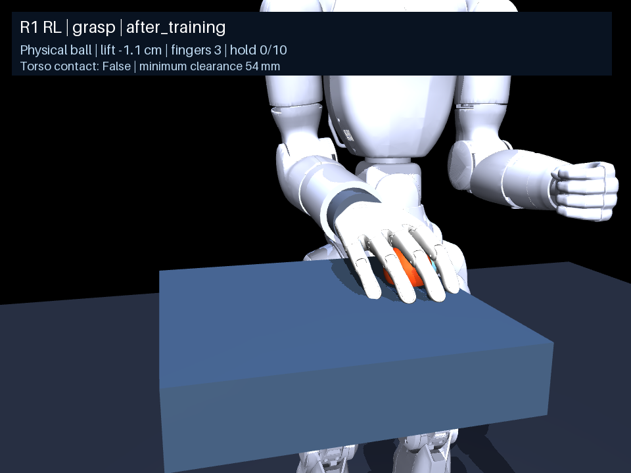
Before focused lift training
0 / 100
nearby lift-and-hold successes
The policy makes finger contact but presses the ball against the table.
Base policy: 1.2 million interactions.
Its contact state starts the next phase.
7
Notes:
Video: /Users/cesarpascal/Documents/Training/real_r1_arm_policy/rl_grasp/runs/physical_grasp_temporal/grasp_after_training_seed8800000_hand.mp4. Evaluation: /Users/cesarpascal/Documents/Training/real_r1_arm_policy/rl_grasp/runs/physical_grasp_temporal/near_report.json. 100 nearby reset episodes, seeds 8800000 through 8800099, 0.015 m spread. After training: 100% any finger contact, 97% terminal contact, 0% lift-and-hold success, 0% drops, 0% torso collision. This baseline evaluation is a different sample/protocol from the 30 continuation-state tests on slide 6. The displayed single video is illustrative.

Slide 8
Progress during focused training
Search episodes | Best held lift | Training success
24 | 0.0 cm | No
48 | 1.8 cm | No
72 | 1.8 cm | No
96 | 7.5 cm | No
120 | 13.5 cm | Yes
Best candidate so far, measured on the training contact state.
8
Notes:
Source: /Users/cesarpascal/Documents/Training/real_r1_arm_policy/rl_grasp/runs/focused_hold_lift/history.json. Cumulative best_held_lift_m per generation, rounded to one decimal cm:0,1.7649,1.7649,7.5,13.4714. Training success false,false,false,false,true. This is best-so-far training performance on one cached contact state, not held-out success. The 13.5 cm during movement differs from the 13.8 cm final stationary-hold height on the following slide. Five-second independent hold verified separately in hold_report.json.

Slide 9
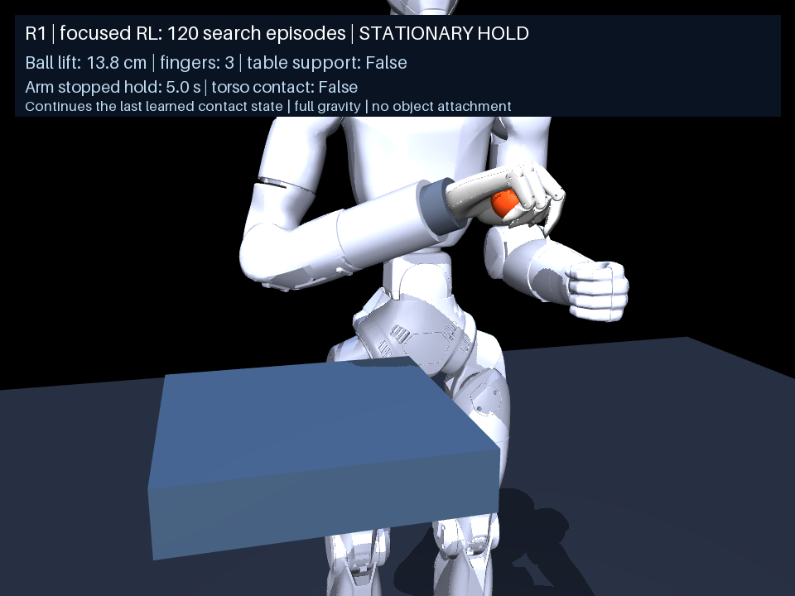
After focused lift training
13.8 cm
lift, followed by a five-second hold
120 reward-only search episodes.
The ball stays off the table after the arm stops.
9
Notes:
Video: /Users/cesarpascal/Documents/Training/real_r1_arm_policy/rl_grasp/runs/focused_hold_lift/lift_and_hold_seed8800000.mp4. Training-state demonstration, not a mean over evaluation episodes. hold_report.json: final height above resting object center 0.137750139 m, minimum over five-second hold 0.13683665 m, maximum 0.13853688 m. Successful hold in all 100 measured hold steps. No drop or torso collision. support_validation.json verifies object support only by right palm/fingers, not table, torso, left arm, or external object. validation.json verifies unchanged gravity, friction, torque limits, free ball joint and no weld. Arm target velocity goes to zero during hold.

Slide 10
Lift-and-hold evaluation
30 nearby contact states | Episodes | Rate
Lift and five-second hold | 20 / 30 | 66.7%
Drops | 4 / 30 | 13.3%
Torso contact | 0 / 30 | 0%
Fresh contact states reached by the existing policy.
Each test uses 8 seconds of motion and a 5-second hold.
10
Notes:
Source: /Users/cesarpascal/Documents/Training/real_r1_arm_policy/rl_grasp/runs/focused_hold_lift/hold_report.json. Held-out seeds 8800100 through 8800129. These are nearby contact-state continuations reached by the existing policy, not arbitrary object poses. 20 successes out of 30, four drops, zero torso collisions. Six remaining failures do not satisfy the lift/hold criterion. The 13.8 cm on slide 5 describes the training-state demonstration only. No claim of general grasp acquisition from arbitrary resets.

Slide 11
Current scope
The arm can lift and hold from a learned contact state.
The focused controller succeeds in 20 of 30 nearby contact states.
Wider starting poses still need evaluation and further training.
CEM learns a timed motion sequence.
Feedback-based recovery is a next step.
11
Notes:
Scope and limitations based on /Users/cesarpascal/Documents/Training/real_r1_arm_policy/rl_grasp/runs/focused_hold_lift/report.json, hold_report.json, validation.json, support_validation.json. These are simulation results. Focused lift search uses open-loop time-conditioned coefficients after the existing SAC contact rollout. No claim of arbitrary-reset grasp success, external disturbance recovery, or safe hardware deployment.

Slide 12
References
[1]
T. Haarnoja, A. Zhou, P. Abbeel, and S. Levine, “Soft actor-critic: Off-policy maximum entropy deep reinforcement learning with a stochastic actor,” in Proc. ICML, vol. 80, 2018, pp. 1861–1870.
[2]
M. Andrychowicz et al., “Hindsight experience replay,” in Advances in Neural Information Processing Systems, vol. 30, 2017.
[3]
S. Mannor, R. Rubinstein, and Y. Gat, “The cross entropy method for fast policy search,” in Proc. 20th Int. Conf. Machine Learning, 2003.
[4]
MuJoCo, “Computation,” MuJoCo Documentation. Accessed: Oct. 21, 2026. [Online]. Available: https://mujoco.readthedocs.io/en/stable/computation/
[5]
Stable-Baselines3, “SAC,” Documentation. Accessed: Oct. 21, 2026. [Online]. Available: https://stable-baselines3.readthedocs.io/en/master/modules/sac.html
12
Notes:
Primary method sources: https://proceedings.mlr.press/v80/haarnoja18b.html ; https://papers.nips.cc/paper/7090-hindsight-experience-replay ; https://cdn.aaai.org/ICML/2003/ICML03-068.pdf . [6] Local run records under /Users/cesarpascal/Documents/Training/real_r1_arm_policy/rl_grasp/runs. HER is an earlier reaching-method reference. CEM is the optimizer used for the focused lift controller.

